Slide 1
Unit 4: Trace Evidence (Chapter 16)

Slide 2
I. Trace evidence=
Physical evidence found at a crime scene in small but measurable amounts
Examples:
hair, glass, fibers, paint, pollen, gunshot residue, soil, etc.

Slide 3
II. Examination of Trace Evidence uses Microanalysis
Microanalysis= application of a microscope to the observation, collection, and analysis of trace evidence
Purpose= To determine if an association of persons, places, and things can be made AND the strength of that association

Slide 4
III. Instruments of Microanalysis
1. Light microscopes
Total magnification = eyepiece mag. (x) objective mag.
TM = EP (x) OBJ
Amount of detail seen/revealed is related to the resolving power of the microscope . . .which is the ability to distinguish differences in fine structure.

Slide 5
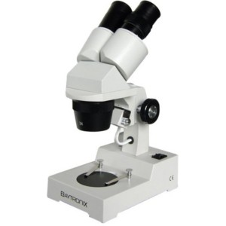
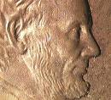
1. Light microscopes cont.
Types of light microscopes
A. Stereo binocular microscope
Used in preliminary evaluation of trace evidence
Constructed fro 2 separate optical microscopes for observation of each eye simultaneously
Utilize reflected light
View has 3-D appearance

Slide 6
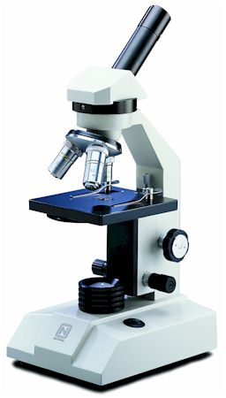
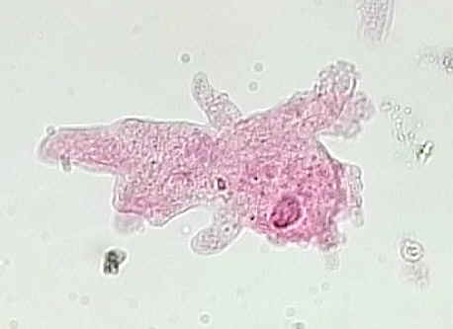
1. Light microscopes cont.
Types of light microscopes
B. Compound light microscope
Most often employed with transmitted bright-field illumination
Allows to see details of construction of evidence
Amoeba magnified 100 x

Slide 7
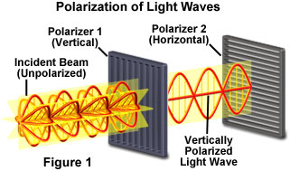
1. Light microscopes cont.
Types of light microscopes
C. Polarized light microscope
Attachment to light microscope that allows for plain polarized light
Vibrations of normal light are in all directions (360 degrees), but if restrict vibration to one direction, you get plain polarized light
Can give better quantitative data (measurements can be made more easily)

Slide 8
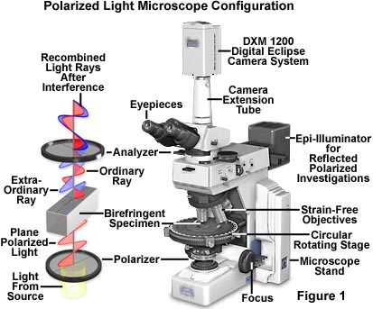
Link to Examples
Images from: http://www.microscopyu.com/articles/polarized/polarizedintro.html

Slide 9
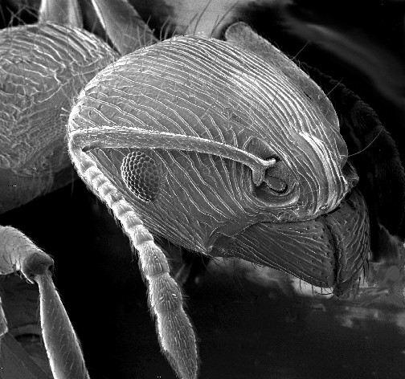
2. Scanning Electron microscope (SEM)
beams of electrons bounced off surface of specimen to produce image
can magnify much more than light microscope . . . SEM has possible range of 10x to 100,000 x
Try it!
Ant magnified ~1500 x

Slide 10
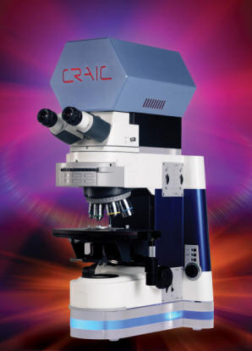
3. Microspectrophotometry
Combines microscope with a spectrophotometer so that light absorption properties of a very small sample can be recorded
Helps experts to determine COLOR of a sample. . . such as with fibers, hair, and painted surfaces

Slide 11
Microscope Review Activity (complete at lab stations)

Slide 12
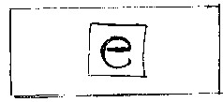
Part A

Slide 13
Part A
e

Slide 14
Part B Illustrates:
Depth of field
-Or-
Depth of focus

